Slide 1

INSPECTMATE
Simplifying Vehicle Inspection Application
SOFTWARE PRODUCT MANAGEMENT
ASSIGNMENT 2
Submitted By – Group AA
Hruday Peddula (Student ID: 2023TM93720 )
Pavana Lakshmi P (Student ID: 2023TM93750)
Supriya P (Student ID: 2023TM93755)
Gayathiri V (Student ID: 2023TM93718)

Slide 2
Product Brief
Assignment - 1 Summary
Application that allows user to do the vehicle inspection using their mobile device from their own location without going to any workshop
Features :
The app will detect the damages present in the vehicle and will give an estimation summary (repair cost) -from which customer can directly analyze the damages and their repair cost even before visiting workshop
Repair cost may not be accurate or what workshop expected -in this case customer provided with the edit option in changing estimate cost
Vehicle rental companies using this application to monitor the rented vehicle (whether any new damages caused by the client rented the vehicle so that they can charge them accordingly this saves lot more money for the rental company)
This application is using by vehicle insurance company -They are using Man-power to do a vehicle inspection ,using this app the company shall provide a link to the customer and they shall use the link to do inspection from their own space which reduces the Man-power
Not only exterior damages -during the process customer shall give each and every details like fuel level, tyre brands, tyre thread depth level ,condition of the interior section etc.

Slide 3



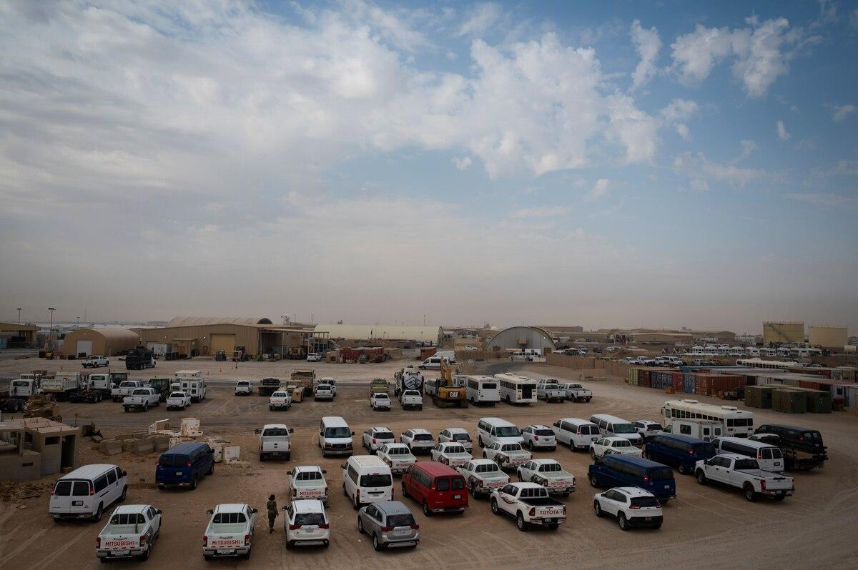
Assignment - 1 Summary
Target Customer Segment/Market
Our software caters to customers who own a vehicle by providing them with a comprehensive and user-friendly platform for repairing, upgrading, and customizing their vehicles
Type 1: Automotive Repair Shops Independent repair shops and franchises specializing in vehicle damage repair. Require efficient processes for assessing, estimating, and repairing vehicle damage |  | Type 2: Vehicle Owners Individuals or businesses owning vehicles in need of repair due to accidents or other damages. Seek reliable and transparent repair services for their vehicles.
Type 3: Insurance Companies Insurance companies may require vehicle inspections as part of the underwriting process to assess risk and determine insurance premiums |  | Type 4: Fleet Managers Companies with vehicle fleets, such as rental car companies, taxi services, delivery companies, and transportation businesses, require regular inspections to maintain the safety and reliability of their vehicles

Slide 4






Key Pain Points
Assignment - 1 Summary
Time Consuming Process:
Inspections often take a significant amount of time, especially if there’s a long queue or if the inspection is thorough.
Inconvenience:
Having to take time out of the day to bring the vehicle in for inspection can be inconvenient, especially if it requires taking time off work or rearranging schedules.
Lack of Transparency:
Some Vehicle owners may feel that the inspection process is opaque, with little explanation provided about what is being checked and why.
Regulatory Compliance:
Inspectors may struggle to keep up with changing regulations and standards, leading to confusion and potential compliance issues.
Technical Issues:
Inspectors may encounter technical difficulties with equipment or software used during the inspection process, leading to delays and frustration.

Slide 5
Value Proposition
Assignment - 1 Summary
Product | Key Pain Points | How Does it Solve | Benefit/Value Proposition | Differentiation from Competition
INSPECTMATE (Simplifying Vehicle Inspection App) | Time-consuming process: Vehicle Inspections often take a significant amount of time, especially if there's a long queue or if the inspection is thorough Lack of transparency: Some vehicle owners may feel that the inspection process is opaque, with little explanation provided about what is being checked and why. Lack of documentation about customer feedback | Online Application that allows customer to do vehicle inspection using their mobile devices from their own location without going to any workshop The inspection details can be shared to customer in the format of pdf / hyperlink Customers satisfaction rate is measured with reviews/ratings | Saves time for customers in few clicks with user guide images Cost Effective E2E Damage detection (Interior/Exterior) Regulatory compliance followed by vehicle inspectors are Up-To-Date | Low / Best cost provider Video based image identification feature of the vehicle damages Online vehicle inspection capability at the comfort of customer Continuous improvements based on customers reviews/ratings

Slide 6
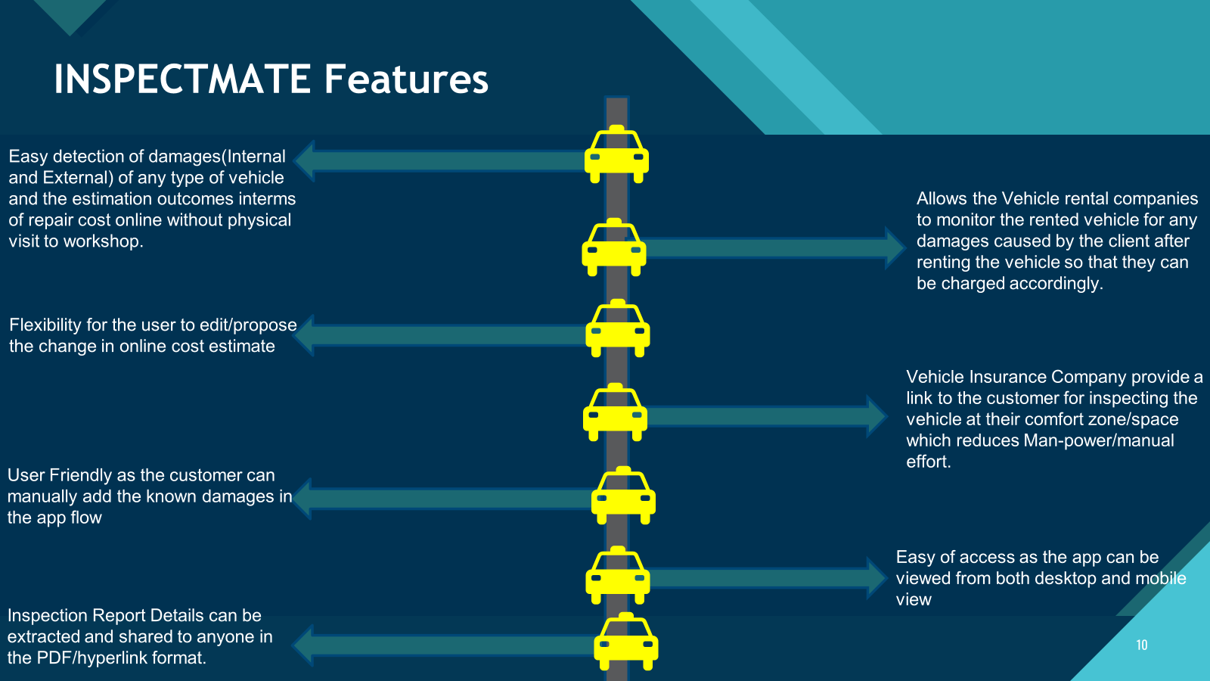
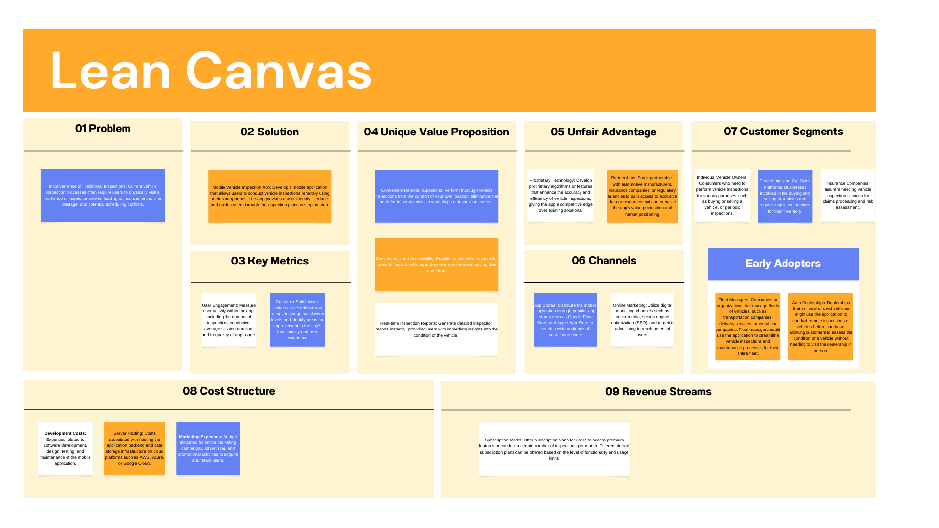
Assignment - 1 Summary

Slide 7
Story Map
Assignment - 1 Summary
User access to the site
Vehicle Inspection
View Inspection History
Vendor Search
Customer Support
User Activities
(Backbone)
Login
Create an account
Perform Vehicle Inspection
Complete Inspection Checklist
Report Generation
Access Inspection History
View History
Avail vendor services
Access Support
User Tasks
(Skeleton)
Username/ email address and password
Fill mandatory details
Select the vehicle to inspect
Review pre-defined checklist items.
Review checklist results and photos.
Navigate to inspection history section.
Select an inspection to view details.
Appointment for damage inspection
Access Help Center
RELEASE 1
Authenticate
Create password
Tap on vehicle to proceed.
Mark each item as pass, fail, or needs attention.
Generate report.
View list of previous inspections.
Review checklist results, photos, and report.
Track damage inspection progress
Submit Support Ticket
Register
Capture photos of any issues or damage found during inspection.
Add comments or photos for each item.
Share report via email or messaging.
View Support History
Share damage parts with vendors
User
Stories
Biometric authentication to login
Annotate photos to highlight specific areas.
Capture signature for inspection approval.
Generate report with signature included.
Initiate a live chat session with customer support.
Schedule pick up & drop from vendor
Video based image identification of damages
Save signature for future reference.
Communicate with support agent to resolve issues or ask questions.
RELEASE 2
Customer rating/reviews

Slide 8


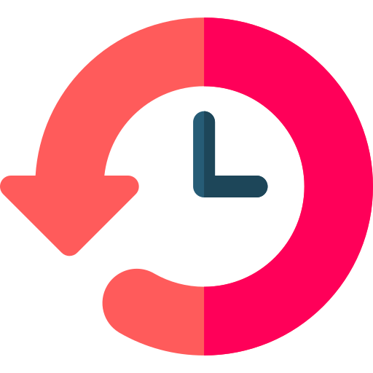


MVP Features
MVP FEATURES (WHAT)
MVP FEATURES (WHY)
User Authentication: User can create an account by entering the mandatory fields using Register option. User logs in to the application with Username and Password credentials.
User Authentication ensures the security feature of the application where the application is protected with registered users only.
Vehicle Inspection: User performs vehicle inspection by selecting the vehicle to inspect, capturing photos of any issues or damage found during inspection and completes the inspection checklist.
Vehicle Inspection feature ensures that the vehicle details along with the snapshot is recorded before fixing the issues. These details are recorded in the inspection checklist to proceed further. This describes the functionality of the application.
Inspection History: User can access Inspection History by navigating to inspection history section and viewing the list of previous inspections.
Inspection History is an important feature to keep track of the list of previous inspections. This demonstrates the storage feature of the inspection datas.
Vendor Search: Vendor Search allows the user to avail vendor services by booking an appointment for damage inspection, tracking damage inspection progress, share damage parts with vendors and schedule pick up & drop from vendor.
Vendor Search is a basic feature which ensures usability of the application where the user can avail vendor services using search feature in few clicks.
Customer Support: Customer can access help center, raise support tickets, initiate a live chat session with customer support and view support history.
Customer support ensures serviceability of the application to support users with help manuals and many more interesting features.

Slide 9
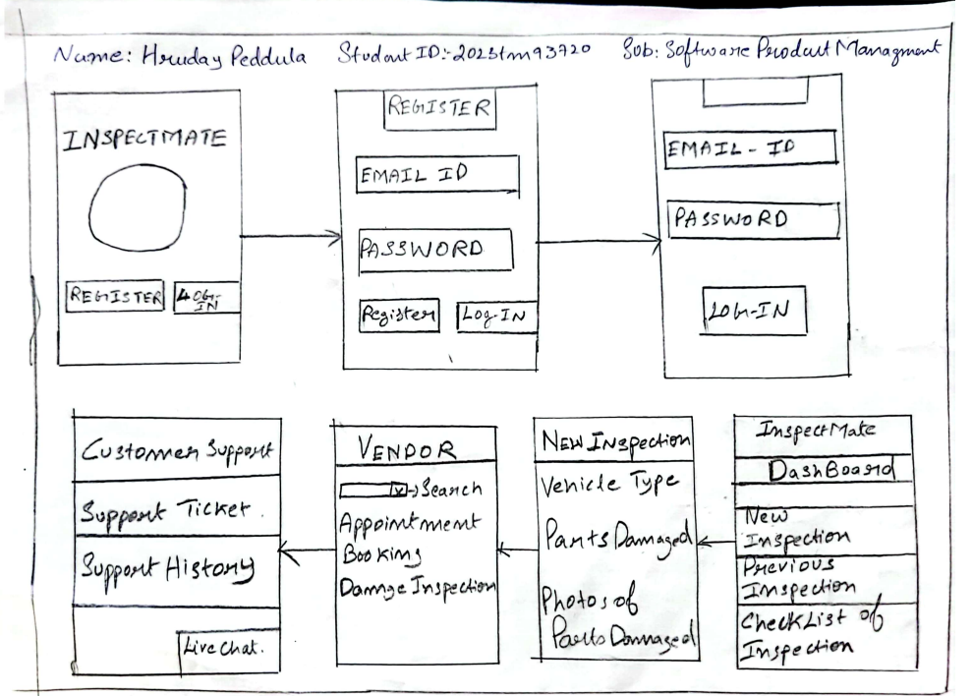
Low Fidelity Diagram - Hruday Peddula - 2023tm93720

Slide 10
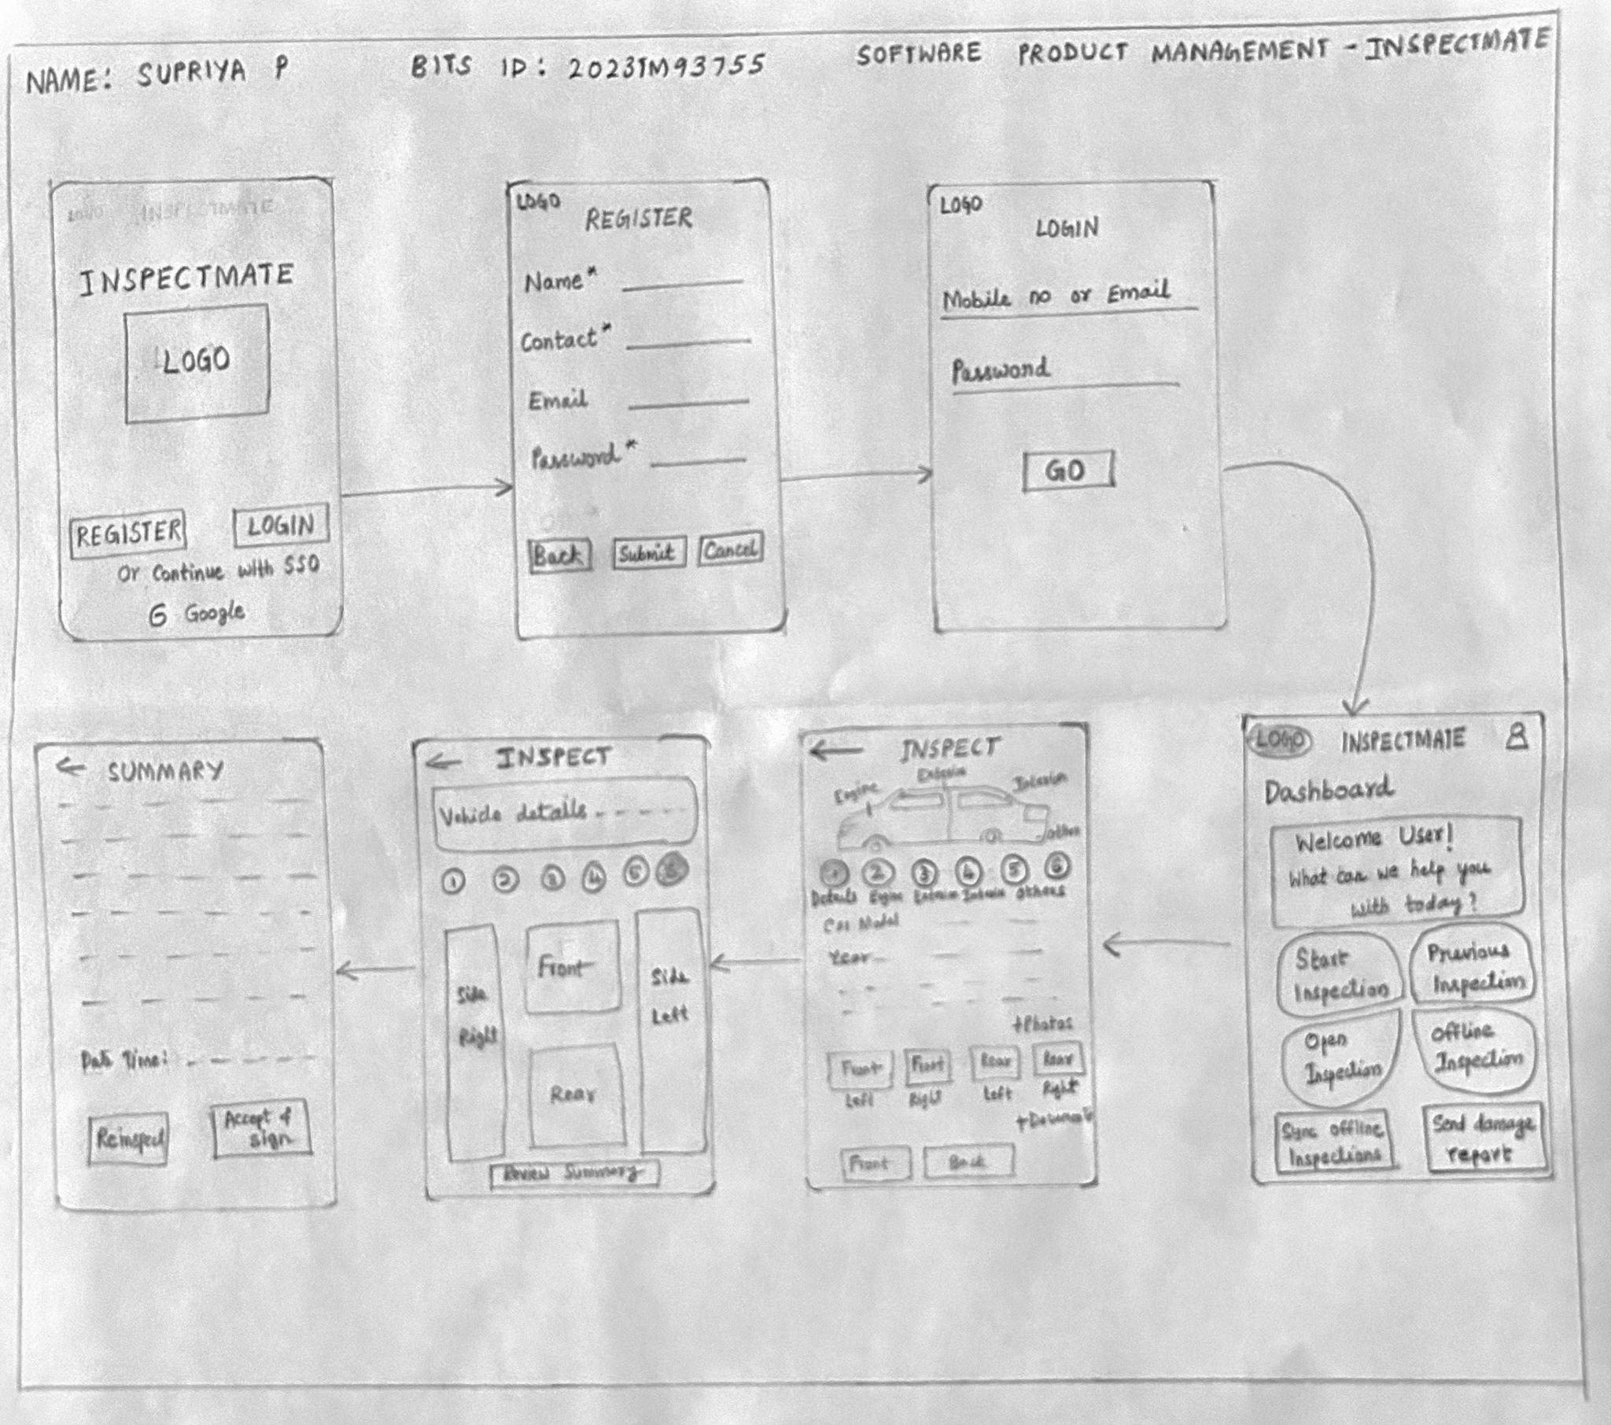
Low Fidelity Diagram - Supriya P 2023tm93755

Slide 11
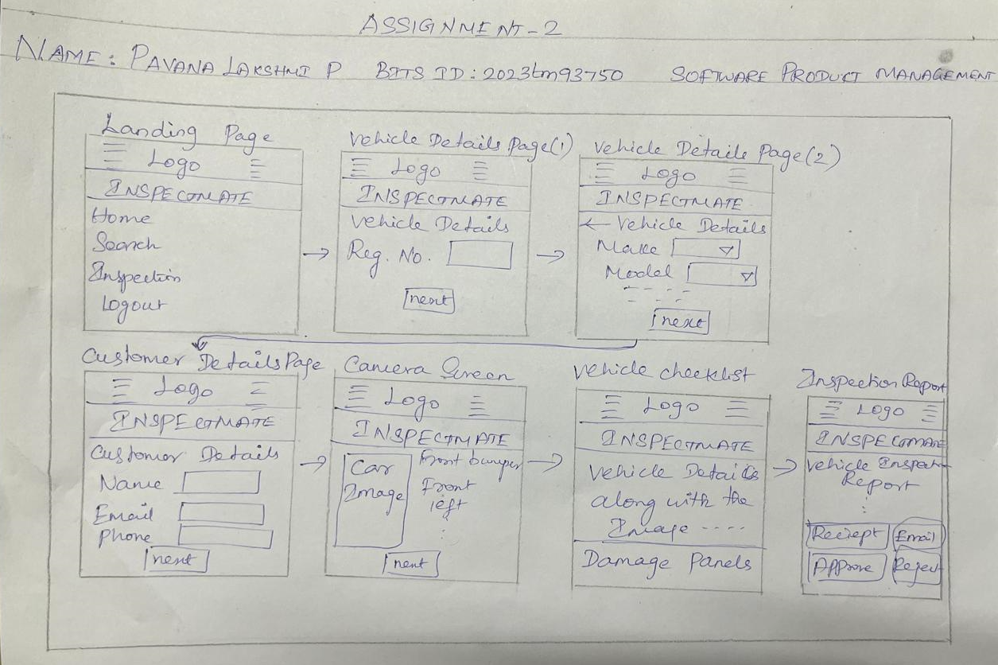
Low Fidelity Diagram - Pavana Lakshmi P 2023tm93750

Slide 12
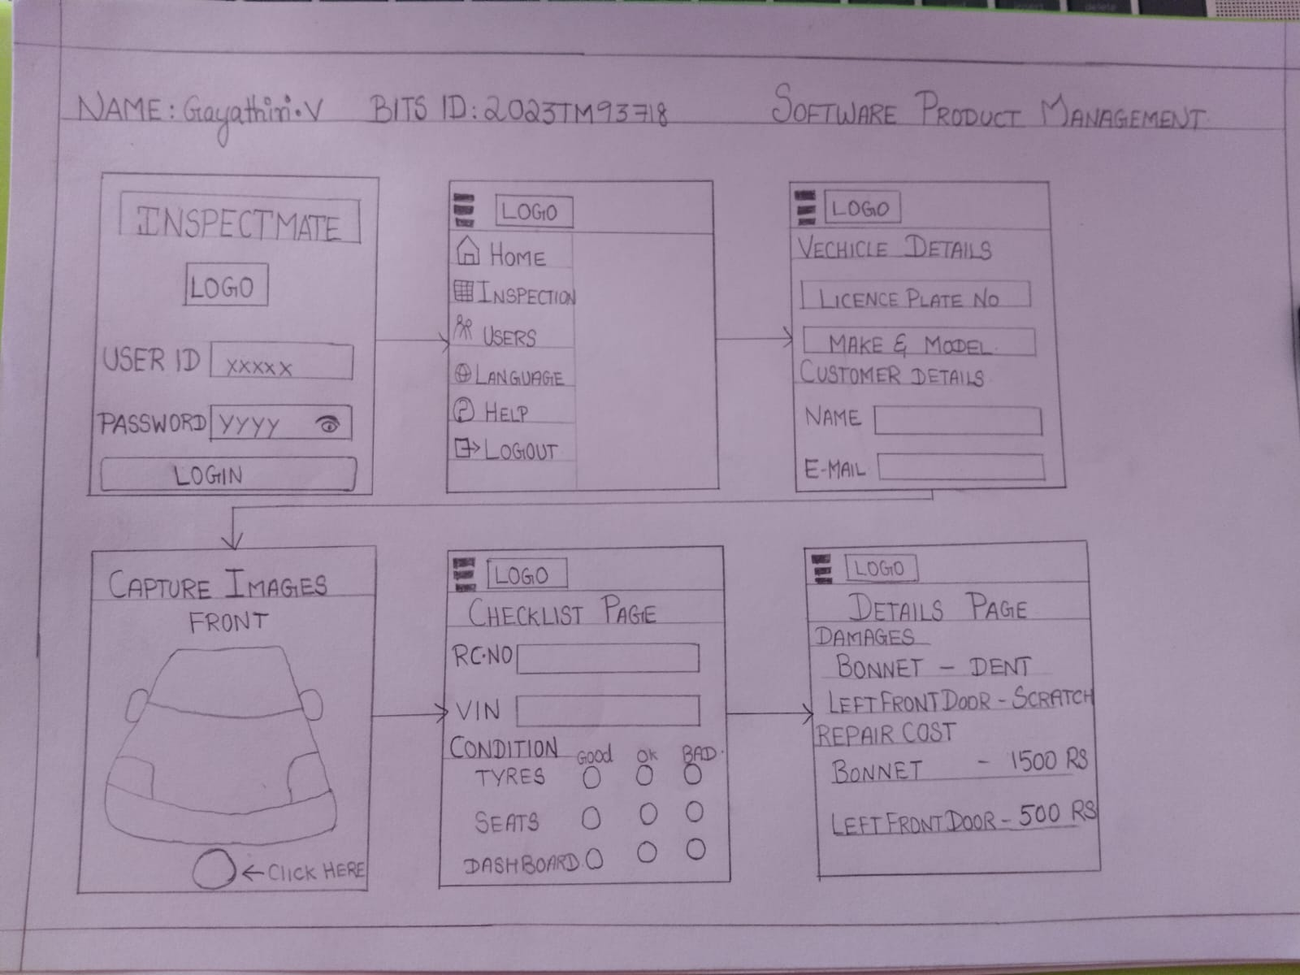
Low Fidelity Diagram - Gayathri V 2023tm93718

Slide 13
Final Low Fidelity Diagram with most votes

Slide 14
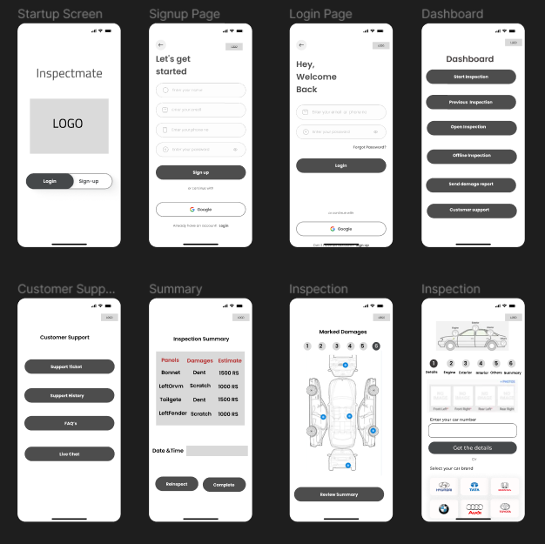
Wireframe Storyboard for the Best Solution
Based on the selected Low Fidelity diagram, we have created a wireframe that includes all the features listed in the finalized sketch.
Startup Screen highlights the Logo and the features Log-in and Sign-up.
Clicking on Sign-up control should display Signup Page with user’s details. Provision to use Gmail is also provided.
Login Page provides the fields – username and password for secured access of further pages.
Inspection Dashboard page displays the features related to Vehicle Inspection.
Inspection Page(s) provides the view of the inspection details along with the snapshot of the vehicle.
Summary list the Vehicle Inspection Summary.
Customer Support is provided for the user to access help manual and contact customer support team with various channels.

Slide 15

Customer Feedback
Customer 2
Customer 3
The app's functionalities are clearly outlined in the wireframes. Allowing customers to alter the style of their dashboard is one recommendation I have to improve the user experience.
The mobile wireframe’s simple design is appealing to me. I value the inspection process’s careful attention to detail, and the navigation looks to be easy to use.
The goal and workflow of the app are clearly communicated in the wireframe. I saw that there is a place to take pictures when conducting inspections. Have you given any thought to including tools for annotating images? Inspectors may find it useful to immediately identify points of concern on the pictures.
Customer 1
Customer 5
Metrics like average inspection time and inspection completion rate would be beneficial to add. To assist users in being organized and proactive, think about incorporating notifications or reminders for impending inspections.
Customer 4
I appreciate the clean design of the mobile wireframe. The inclusion of graphical representation showcasing the number of inspections in queue, complete, and in progress is essential for a fleet manager. This feature provides precise data at a glance, enabling quick decision-making and efficient resource allocation.

Slide 16


Validate: Customer Queries in Feedback and Our Solutions
Based on the wireframe presentation, we received feedback from our potential customers on specific aspects of the application. Here are the questions raised and the proposed solution:
Our Solution: Including tools for annotating images can greatly improve communication between inspectors and customers, as they can easily identify and highlight problems directly from the images. I will definitely consider adding this feature to future iterations of the app.
Customer 1 Query: Have you given any thought to including tools for annotating images? Inspectors may find it useful to immediately identify points of concern on the pictures.
Customer 2 Query: Allow customers to alter the style of their dashboard
Our Solution: will consider adding this in future iterations.
Customer 4 Query: The inclusion of graphical representation showcasing the number of inspections in queue, complete, and in progress is essential for a fleet manager.
Our Solution: Updated the wireframe in the next slide based on the customer 4 query
Customer 5 Query: Metrics like average inspection time and inspection completion rate would be beneficial to add.
Our Solution: Updated the wireframe in the next slide based on the customer query

Slide 17
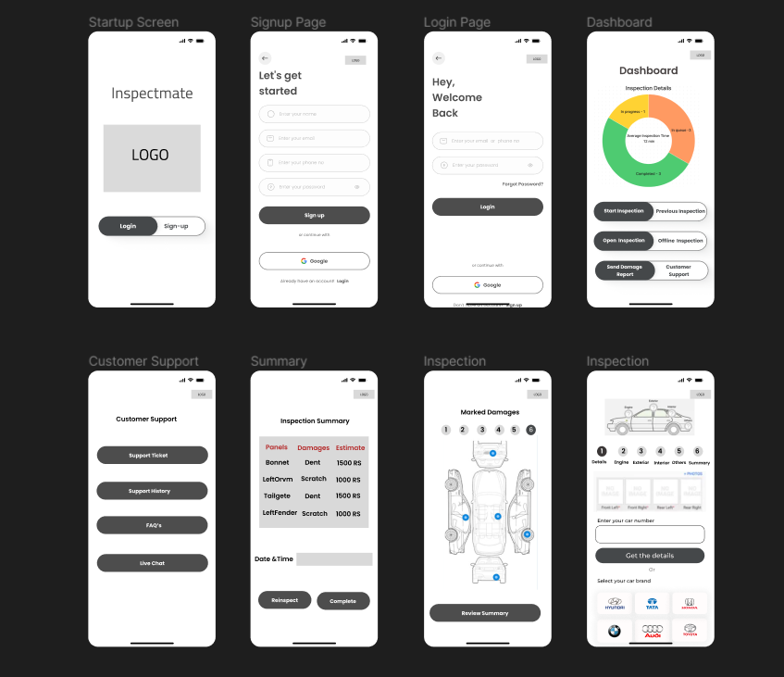
Iterate: Updated Wireframe Storyboard
Based on the customer feedback and queries, we have updated a wireframe that includes the below features:
Alter Dashboard – Flexibility to alter dashboard is added for the user to view based on their requirement.
Metrics – Metrics like average inspection time and inspection completion rate added.

Slide 18
Key Learnings – Pavana Lakshmi P (2023tm93750)
Learnt about low fidelity hand-sketches, which is quick and easy way to visualize the layout and structure of an product/application.Collaborated with the team to vote for the best stand-out sketch and ideas.
Understood the importance of focusing on MVP features that are most important to the user, add the most value and require the least amount of effort to develop.
Experienced the significance of receiving customer feedback during the initial phases of product development which is crucial in delivering a Minimum Viable Product(MVP).
Got deeper understanding about wireframe storyboard that lies in its ability to facilitate comprehension of the final product’s look and feel and its features.
Learnt about storyboarding in terms of selecting the best ideas from the wireframe and the importance of customer feedback.Also, updated the wireframe based on the customer feedback.

Slide 19
Key Learnings – Hruday Peddula (2023tm93720)
Got more understanding on the importance of MVP features and selecting the MVP features from the story map.
Understood the concept and importance of low fidelity diagrams.
Got to know how storyboard help in designing the application flow well before development.
Storyboard also it helped in taking the customer opinion before actually implementing the software.
Validating and modifying the storyboard helps to finalize the product look and feel based on the user’s opinion and suggestions.

Slide 20
Key Learnings – Supriya P (2023TM93755)
Understood how to identify and prioritize the most important features of a product based on needs of the users and the goals of the project for developing an effective MVP.
Low-fidelity diagrams have been found to be valuable for generating ideas, facilitating discussions, and gathering early feedback without too much time and effort.
Learnt how to translate conceptual ideas into concrete layouts with a focus on structure and user flows.
Learnt to collect, analyze and prioritize customer feedback to improve solutions.

Slide 21
Key Learnings -Gayathiri V (2023TM93718)
Understood the concept and importance of MVP feature and how it applies in a product
Using a low fidelity diagram get a better knowledge on the starting process of the product and how its done
Have gathered knowledge on the product and applied on the wireframe to get a complete model of the product
Using the collected customer feedbacks have made changes in the wireframe and updated it that helps to understand how customer centric one product should be

Slide 22
Thank you!

